Slide 1
Week 19
Simple Linear Regression(continuation)
Topics to be covered:
Main assumptions of simple linear regression
Coefficient of Determination (R²)
Confidence interval for regression coefficients
t-test for the slope
F-test for overall significance of the model

Slide 2
Main assumptions of simple linear regression model (Diagnostics)
Linearity: The relationship between X and the mean of Y is linear.
(Scatter plot)
Homoscedasticity: The variance of residual is the same for any value of X.
(Residual plot)
Independence: Observations are independent of each other.
(Cross-sectional vs Time-series data)
Normality: For any fixed value of X, Y is normally distributed.
(Normality plot, histogram of residuals)

Slide 3
Coefficient of Determination (R Squared)
R-squared (R²) is a statistical measure of how close the data are to the fitted regression line. It is also known as the coefficient of determination, or the coefficient of multiple determination for multiple regression.
R² = r² ( square of correlation coefficient)= SSR/SST
R² is the proportion of the variance in the dependent variable that is predictable from the independent variable(s).
R-squared is always between 0 and 1 (or 0 and 100%):
0% indicates that the model explains none of the variability of the response data around its mean.
100% indicates that the model explains all the variability of the response data around its mean.

Slide 4
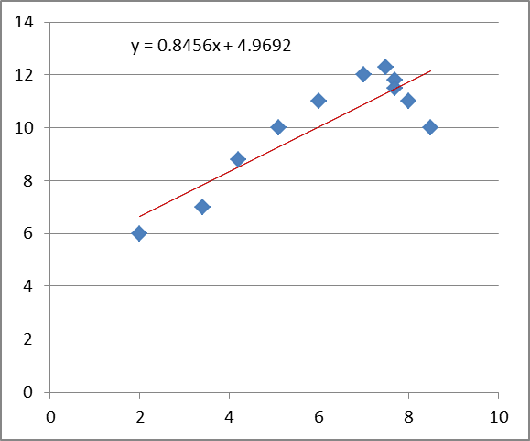
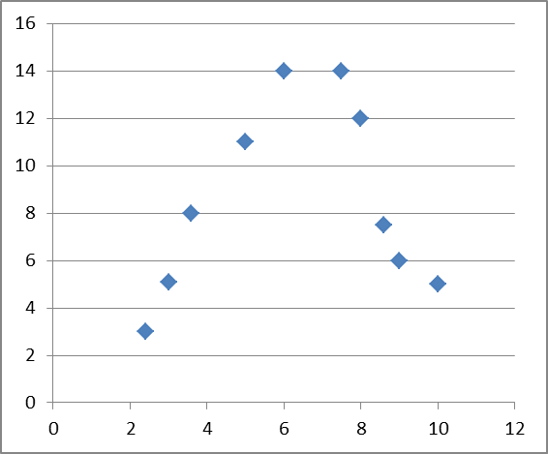
Misconception 1: A high R² indicates that the estimated regression line is a good fit.
Misconception 2: R² near zero indicates that X and Y are not related.
R² = 0.76 (Straight line is not good fit)
R² = 0.04 (But strong relation bet. X and Y)

Slide 5
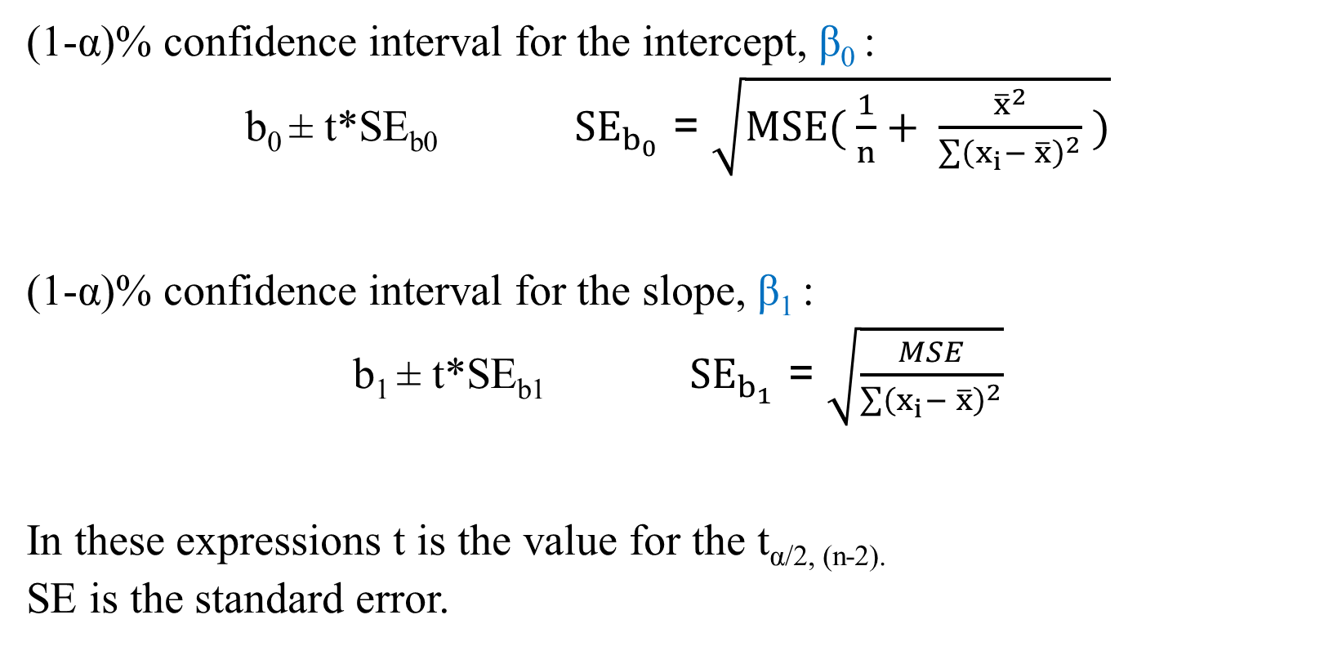
Confidence intervals for regression coefficients
(1-α)% confidence interval for the intercept, β₀ :
b₀ ± t*SE_{b0} ${SE}_{b_{0}}$ = $\sqrt{MSE( \frac{1}{n}+ \frac{{\overline{x}}^{2}}{\sum{{\left(x_{i}− \overline{x}\right)}^{2}}} )}$
(1-α)% confidence interval for the slope, β₁ :
b₁ ± t*SE_{b1} ${SE}_{b_{1}}$ = $\sqrt{\frac{MSE}{\sum{{\left(x_{i}− \overline{x}\right)}^{2}}}}$
In these expressions t is the value for the t_{α/2, (n-2).}
SE is the standard error.

Slide 6
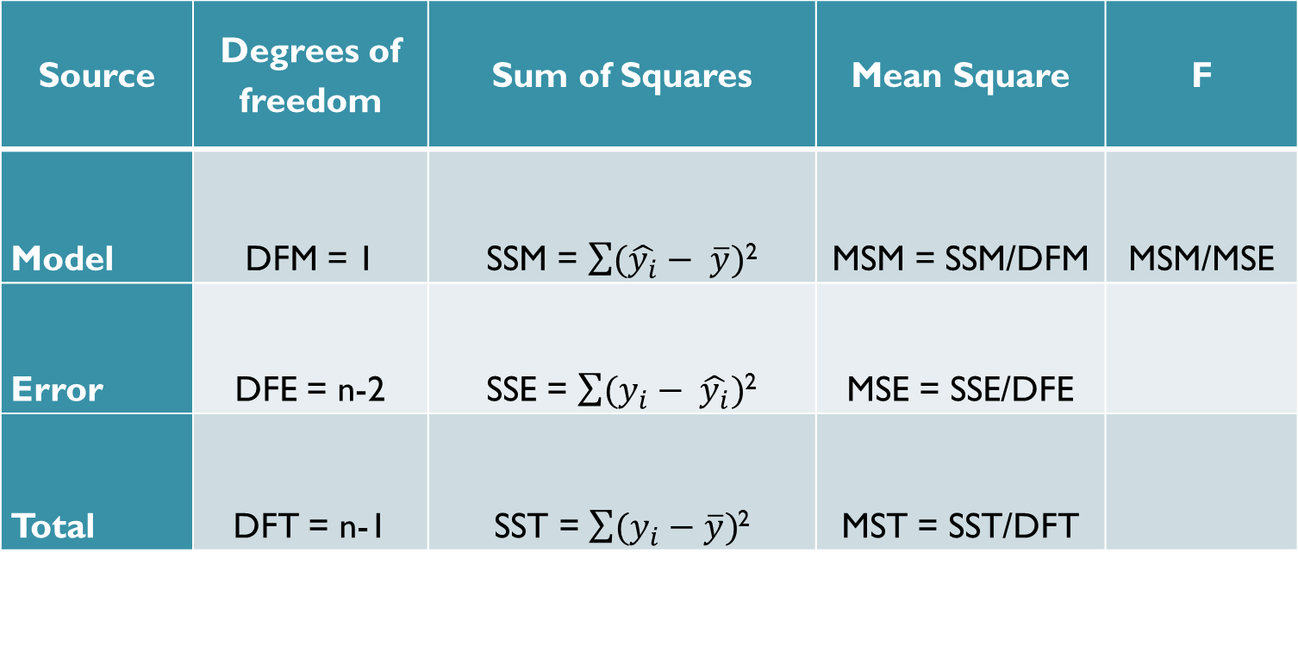
ANOVA Table for Simple Linear Regression
Source | Degrees of freedom | Sum of Squares | Mean Square | F
Model | DFM = 1 | SSM = $\sum{(\hat{y_{i}}}− \overline{y})$² | MSM = SSM/DFM | MSM/MSE
Error | DFE = n-2 | SSE = $\sum{(y_{i}}− \hat{y_{i}})$² | MSE = SSE/DFE
Total | DFT = n-1 | SST = $\sum{(y_{i}}−\overline{y})$² | MST = SST/DFT

Slide 7
Hypothesis test in simple linear regression
H₀: β₁ = 0 says that there is no linear relationship between y and x and that linear regression of y on x is of no value for predicting y.
H_{a}: β₁ ≠ 0 says that there is statistically significant linear relationship between y and x.
There are two tests which will provide the same conclusions, because there is only one independent variable (this only applies to simple linear regression):
t-test.
F-test.

Slide 8
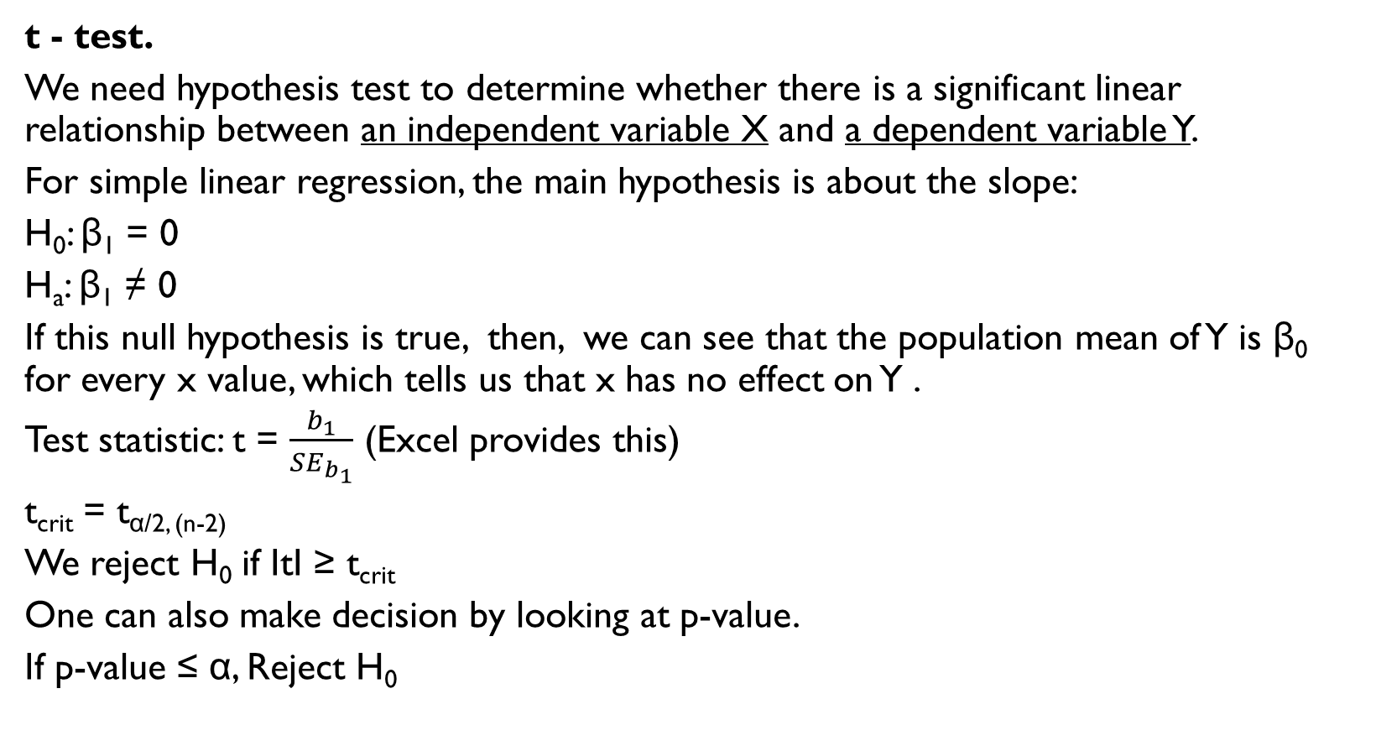
Statistical hypotheses for simple linear regression
t - test.
We need hypothesis test to determine whether there is a significant linear relationship between an independent variable X and a dependent variable Y.
For simple linear regression, the main hypothesis is about the slope:
H₀: β₁ = 0
H_{a}: β₁ ≠ 0
If this null hypothesis is true, then, we can see that the population mean of Y is β₀ for every x value, which tells us that x has no effect on Y .
Test statistic: t = $\frac{b_{1}}{{SE}_{b_{1}}}$ (Excel provides this)
t_{crit} = t_{α/2, (n-2)}
We reject H₀ if ItI ≥ t_{crit}
One can also make decision by looking at p-value.
If p-value ≤ α, Reject H₀

Slide 9

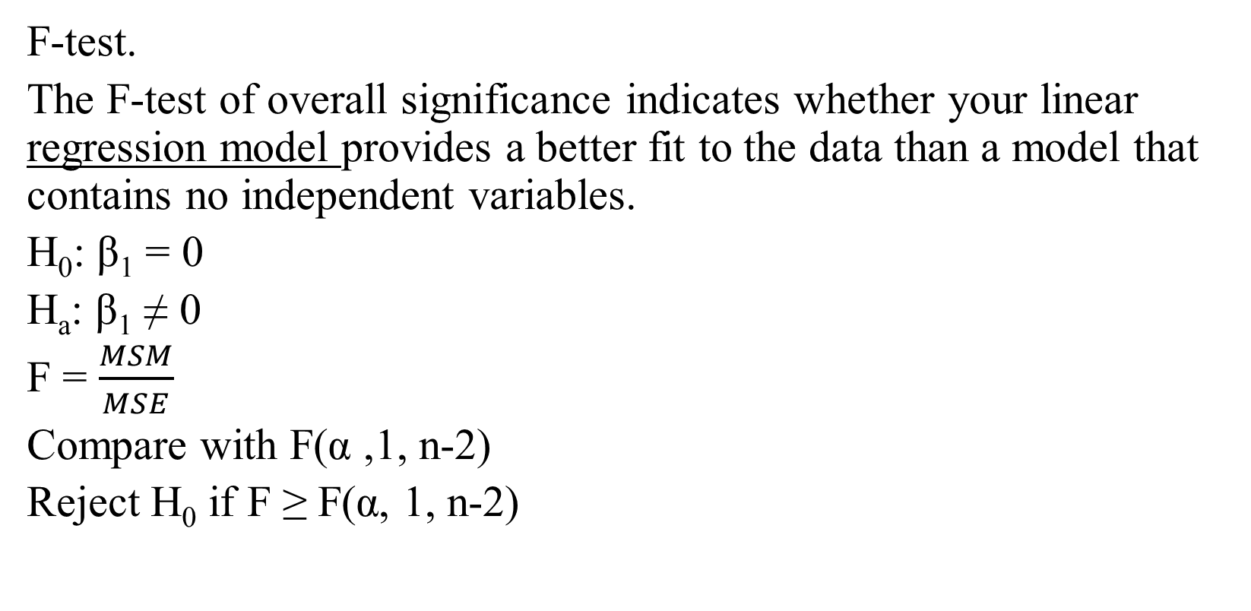
Statistical hypotheses for simple linear regression
F-test.
The F-test of overall significance indicates whether your linear regression model provides a better fit to the data than a model that contains no independent variables.
H₀: β₁ = 0
H_{a}: β₁ ≠ 0
F = $\frac{MSM}{MSE}$
Compare with F(α ,1, n-2)
Reject H₀ if F ≥ F(α, 1, n-2)

Slide 10

Simple Linear Regression
Example.
The following data was obtained from the website https://olx.uz. Asking price and odometer of 10 cars
of the same model (Toyota Camry)
were collected. Our goal is to build a
simple regression model to predict
car price based on its odometer.
Asking Price ($) | Odometer (km)
$18,500 | 209000
$12,500 | 238600
$37,000 | 30000
$13,500 | 319000
$15,000 | 320000
$48,000 | 38257
$15,000 | 180000
$14,500 | 125000
$15,000 | 220000
$13,500 | 192000

Slide 11
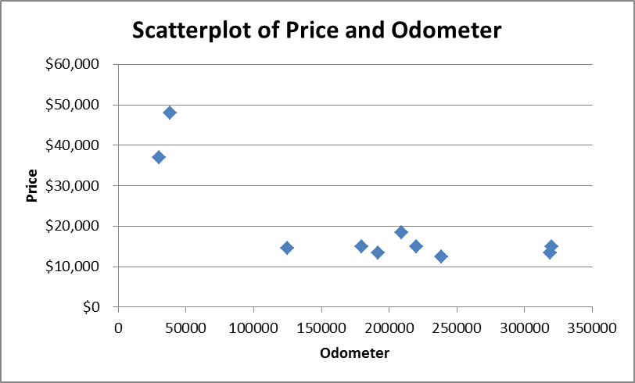
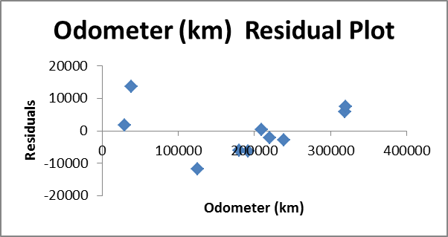
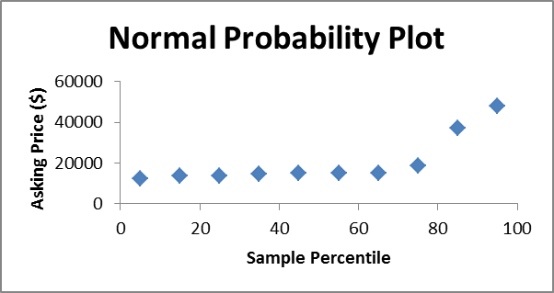
Diagnostics

Slide 12
Excel Output
ANOVA
 | df | SS | MS | F | Significance F
Regression | 1 | 8.21E+08 | 8.21E+08 | 13.15349 | 0.006716
Residual | 8 | 4.99E+08 | 62430599
Total | 9 | 1.32E+09
 | R Square = SSR/SST |  |  |  | Same
 | Coefficients | Standard Error | t Stat | P-value | Lower 95% | Upper 95%
Intercept | 38126.1873 | 5526.084 | 6.899313 | 0.000125 | 25383.01 | 50869.36
X Variable 1 | -0.0954997 | 0.026332 | -3.62677 | 0.006716 | -0.15622 | -0.03478

Slide 13
Interpretations of our linear fit model
Based on Excel results our model is:
Car Price = 38126 – 0.095*Odometer
b₀ = 38126 indicates average price for Toyota Camry when odometer = 0 km.
b₁ indicates change in average price of Toyota Camry when the odometer changes by one unit. Hence, when odometer increases by 1 km, the price of Toyota Camry, on average, decreases by $0.095 or 10 cents.
R Square = SSR/SST = 8.21/13.2 = 0.622 (62.2%)
R Square indicates that 62.2% of variation in car price can be explained by the given model. The remaining variation in the price (100-62.2 = 37.8 %) is coming from other factors which are unknown to us.

Slide 14
Confidence Intervals for regression coefficients.
 | Coefficients | Standard Error | t Stat | P-value | Lower 95% | Upper 95%
Intercept | 38126.1873 | 5526.084 | 6.899313 | 0.000125 | 25383.01398 | 50869.36
X Variable 1 | -0.0954997 | 0.026332 | -3.62677 | 0.006716 | -0.156221155 | -0.03478
We are 95% confident that intercept (β₀) of our model is between 25,383 and 50,869.
We are 95% confident that slope (β₁) of our model is between -0.156 and -0.034.

Slide 15
Hypothesis testing
Hypothesis:
H₀: β₁ = 0 or
There is no significant linear relationship between car price and its odometer.
H_{a}: β₁ ≠ 0 or
There is a significant linear relationship between car price and its odometer.
Rejection: (We will use α=0.05 for this exercise)
We reject H₀ if p-value ≤ α
For simple linear regression we can use either t-test or F-test, because both will give the same conclusion. (But they have different interpretations in Multiple Regression).

Slide 16
Conclusion
Excel output only provides t-stat and F-stat. If you want to find out critical values, you should refer to either distribution tables or Excel functions (t.inv.2t(0.05, 8), F.inv.rt(0.05, 1, 8).
t-test.
I t-stat I = I -3.63 I > t-crit(0.025, df=8) =2.31 or
p-value = 0.0067 < α = 0.05
F-test.
F-stat = 13.15 > F-crit(0.05, 1, 8) = 5.32 or
p-value = 0.0067 < α = 0.05
In both tests we reject the null hypothesis and conclude that our linear model fits the data better than the intercept-only model. There is a significant linear relationship between the price of the car and its odometer.

Slide 17
Literature
Holmes et al. Introductory Business Statistics. Chapter 13.
McClave, Sincich. Statistics. Chapter 11.
https://www.coursera.org/lecture/business-statistics/3-4-2-simple-linear-regression-excel-output-analysis-JYZRG

